Slide 1
Mechatronics Systems Pvt. Ltd.
Water
Every drop count !!
Smart Digital Integrated Water Resource Management & Control System

Slide 2
Key Strengths
Mechatronics Systems Pvt. Ltd.

Slide 3
Mechatronics, with 20 years of heavy investment in R&D for water resource management sector is in the fore front, and a step ahead of its competitors. Established in 1991, we are the first company to get ISO 9001-2008 and CMMI 3 certification for Integrated water resource management.
Mechatronics has grown to become the biggest and only Smart Digital Integrated Water Resource Management company in India. Mechatronics is the only company in India which has undertaken major projects in water resource management and has track record of successful implementation of mega projects.
Mechatronics dominates the water resource management sector in India with a major share of the projects implemented across India.
Mechatronics has strong technological and strategic alliances with major product companies across the world. Robust and time tested product & services has earned Mechatronics laurels from customers worldwide.
Mechatronics Systems Pvt. Ltd.

Slide 4
Strong R&D in software and IT systems and products in areas such as M2M, internet of things, data analytics has helped Mechatronics in catapulting its software product division as a major revenue driver of the company.
Indigenous products such as RTUs, data loggers, solar powered gate actuators, hydro metrological instruments, fully automated solar powered canal gates, telemetry systems, E-Governance, MIS, SCADA software, Utility water management systems, Web and Smartphone applications.
Country wide presence with regional sales and service offices such as Jaipur, Bhopal, Mysore, Nagpur, Ahmedabad, Chennai, Bangalore
A strong team of 200 professionals comprising of software engineers, hydrologists, electronics and instrumentation engineers, business graduates, installation and commissioning engineers and over 200 years of combined experience
Mechatronics Systems Pvt. Ltd.

Slide 5
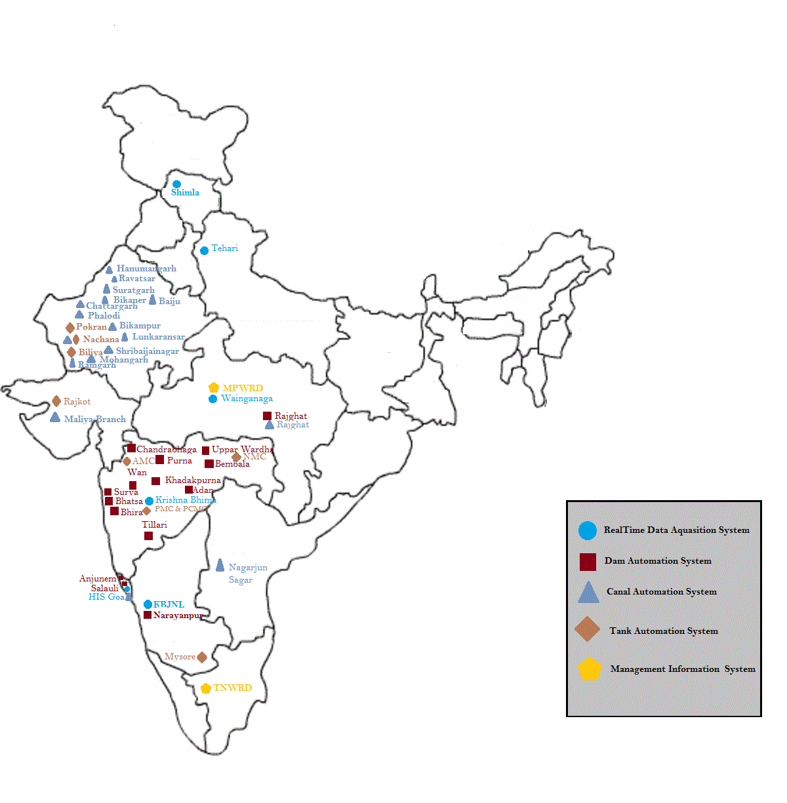
Mechatronics Presence in all over India
Mechatronics Systems Pvt. Ltd.

Slide 6
Our Business areas
Mechatronics Systems Pvt. Ltd.

Slide 7
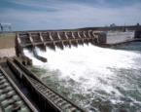
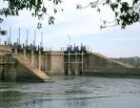
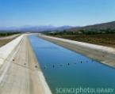
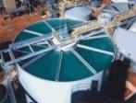
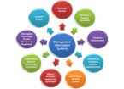
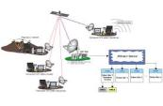
Our Business areas
Hydro meteorological information systems
Flood forecasting and flood management systems with Dam Automation
Canal Automation and
Smart Irrigation Management Systems
Smart City Water Supply Management
Geographical Information System (GIS)
Enterprise Management Information System (MIS)
Telemetry System
Smart Phone Application
Mechatronics Systems Pvt. Ltd.

Slide 8
Our Business areas
Hydro Meteorological Information System
Flood Forecasting & Flood monitoring system with Dam Automation
Canal Automation & Smart Irrigation Management System
Enterprise Management
Information System
Geographic Information System (GIS)
Smart City water Supply Management
Real Time Rainfall Measurement
Real time River Level & Discharge Measurement
Automatic Full Climate
Reservoir water Level & Outflow discharge
Integration to Hydro Meteorological system for accurate Reservoir operation
Early Flood warning & inflow forecasting system
Spillway gate control for flood Management
Canal Regulation & Control System
Water Demand & Allocation
Crop water Requirement
Crop Revenue & Water Billing
Soil Health Card
Fully Automated gates
Irrigation & Water Management
Flood Control & Dam Safety
Project Mgmt
Asset Mgmt
Billing & Revenue Collection
Canal Network
Crop Pattern
Soil Health
Land Use & Land Cover
WUA & Farmer Information Kiosk
Base Map, Cadastral Map
Water Audit
Energy Audit
Pumping station Automation
WTP & Filter Bed Automation
Water Quality parameter monitoring & control
VALUE PROPOSITIONS
One stop Info
Operational Efficiency
Better Visibility and Interactions
Quick actions on IWMS
Ready Reference of Technical data
Mechatronics Systems Pvt. Ltd.

Slide 9
Total Digital Smart Solution
Enterprise Management Information System (EMIS) & e-Governance
Canal Automation & Smart Irrigation System with Crop Water Requirement
Real Time Flood Forecasting & Flood Management System
Hydro Meteorological Information System
Geographical Information System (GIS)
Value Added Application ( Web site, Smart Phone Application, SMS Based system)
Smart City Water Supply Management
WRD e-Governance
Mechatronics Systems Pvt. Ltd.

Slide 10
Good data leads to good outcomes!
Most of us have the luxury of taking the data for granted. Without the experience of what would happen if we didn’t have data to inform our decisions we lack appreciation for the difference it makes in our lives.
The need for water resource management backed by timely accurate data is highlighted in these situations.
The combination of accurate meteorological and hydrometric data can allow for informed decision making, design, flood warnings and resource allocation in situations like this. After the fact the data needs to managed, interpreted, finalized and communicated to all stakeholders.
Having the right tools in the office is just as important as having the right tools in the field.
Mechatronics Systems Pvt. Ltd.

Slide 11
Hydro meteorological Information Systems
Surface Water & Ground Water information and Management System
Dam Reservoir Gauging stations
River level and discharge gauging stations
Rainfall and Weather monitoring stations
Gate measurement systems
Stage Discharge recorders
Wireless telemetry solutions over GSM/GPRS/Satellite/ VHF
Data collection platforms, RTUs and sensor interface for wide array of sensors
Software systems for DSS, database storage, analysis software
Flood Forecasting and Management Systems, Dam Automation
Early Flood Warning and Inflow forecasting systems
Dam & Canal gates control for Flood Management
Warning & Alarms system and information dissemination to disaster cells & public
Integration to Hydro meteorological system for accurate water inflow information
Centralized control system over huge area at division level/ state/inter state level/ country/inter country level
Mechatronics Systems Pvt. Ltd.

Slide 12
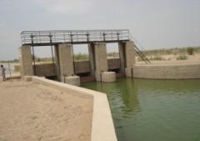
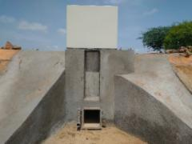
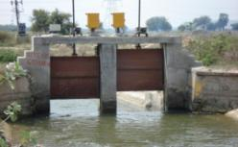
Canal Automation Systems and Smart Irrigation Management
Smart Irrigation Management using sensors for monitoring water flow/ level, automated gates, delivery schedules, increasing efficiency of irrigation, reducing maintenance
Web based SCADA software for integrated canal control/monitoring, demand based supply
Irrigation Network Management Information System (INMIS) for water allocation and billing and database management,
Geographic Information System (GIS) for command area mapping, thematic layers, cropping patterns, meteorological data,
Solar powered Autoflow gates
Canal flow measurement stations
HR/CR gate controllers, retrofitting
Flow control stations (Upstream, Downstream, Constant Volume control)
Variety of flow and level devices
Wireless telemetry solutions over satellite/GSM/GPRS/VHF
Mechatronics Systems Pvt. Ltd.

Slide 13
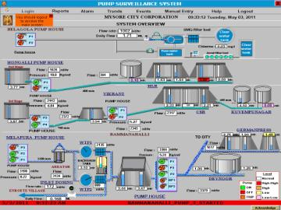
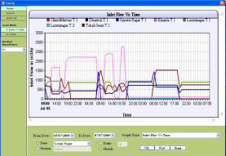
Smart City Water Supply Automation
Centralized monitoring and control of urban water supply, Predictive & Business Analytics for demand based supply, increasing water efficiency, reducing Non revenue water, increasing revenue by smart billing, reducing maintenance, asset management,
AMR for domestic and bulk water meters
ESR, GSR monitoring
WTP automation
Water quality monitoring
Flow monitoring
Control valve automation
Pump: Energy monitoring and automation
Leakage detection
Water and Energy audit
Water metering solutions
Remote Terminal Units (RTU) with built in PLC
SCADA software, data storage and analysis software
Mechatronics Systems Pvt. Ltd.

Slide 14
E-Governance
IMPROVE
GOVERNMENT
EFFICIENCY
Reduce costs by eliminating paperwork and improving processes
Enhance collaboration and knowledge sharing within government
Obtain skilled and capable staff and train existing staff
IMPROVE
CITIZEN
SERVICE
Convenient: 24x7 self-service
Customized: tailor service delivery to customer needs
Consistent: predictable and reliable
Build community among global citizens, suppliers, employees and stakeholders
Increase transparency, consistency and predictability
Create attractive environment for foreign investment in the country
Increase access of national businesses to the world economy and markets
Facilitate the formation of businesses and increased employment
PROMOTE
ECONOMIC
COMPETITIVENESS
Mechatronics Systems Pvt. Ltd.

Slide 15
Mechatronics Systems Pvt. Ltd.

Slide 16
Geographical Information System
Base Maps Preparation
Contour Maps Preparation
Cadastral Maps Preparation
Thematic Maps Preparation
Real Time Data Integration with GIS
Analytics Based on GIS
Land Use & Land Cover (Land Records Details from Revenue Dept.)
Crop Health Analysis
Environmental Assessments
Precision Agriculture
Hydrology
Wetland Delineation
Thematic Mapping
Base Map / Land Use and Land Cover / Canal Network
Contour & DEM
Cadastral Mapping
Crop Mapping
GIS Application
Mechatronics Systems Pvt. Ltd.

Slide 17
Products & Systems
Mechatronics Systems Pvt. Ltd.

Slide 18
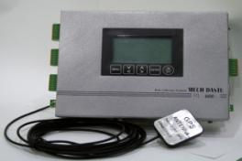
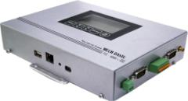
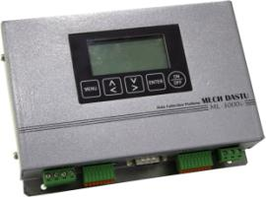
Data Collection Platform
MECH-DASTU series of data collection platform are robust, field proven devices, designed to operate in harsh environments and capability to interface with wide array of field sensors.
With connectivity features such as Ethernet/ RS232/ RS 485/ USB / SDI 12 they truly connect to a smart network, and internet of things
Interface to any telemetry networks VSAT/INSAT/GSM/GPRS/VHF/UHF etc.
Works as a Remote Terminal Unit (RTU) with built in Logic Controller for control and automatic operation of a Spillway/HR/CR/Laterals/DPO gates, valve actuators,.
Mechatronics Systems Pvt. Ltd.

Slide 19
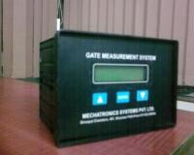
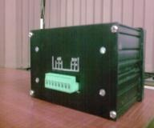
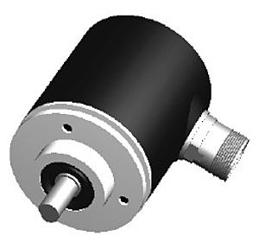
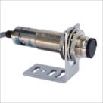
Gate Measurement System (GMS)
MECH-GMS is specially designed measurement system for radial, vertical and screw type gates of Dams and Canals
This can be interfaced with variety of sensors like linear/rotary/absolute encoders and optical encoders. Special function for conversion of radial gate opening to vertical opening.
With these kind of sensors it is easy to integrate the controlling structures in a irrigation network to a smart network
Mechatronics Systems Pvt. Ltd.

Slide 20
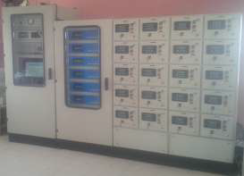
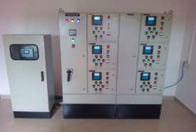
Control Console
Micro controller based fully Compatible with any RTU for Remote / Local operations from control center.
Remote and/or Local Auto / Manual Mode selection facility
Equipped with Single phasing preventer and safety fuses.
Digital display of Gate status
Overload protection with indication on front panel.
Protection for dry pumping , priming failure, vibration, temperature, under / over voltage
Variable control voltages.
Variable frequency Drives (VFD)
Local / Field operation facility
Interlocking for auto / manual operation.
Space Heaters, illuminating lamp.
Cable glands for cable entry at bottom
Mechatronics Systems Pvt. Ltd.

Slide 21
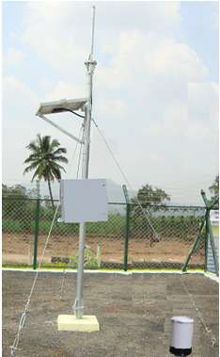
Automatic Rainfall station
Self-Reporting at predefined programmable time interval
Selectable Station ID
Local Data Storage for one year with Data retrieval facility
Programmable Data Storage interval from 1.00 min to 24.00 Hrs.
Local Display facility using VGA graphics LCD display
Two RS-232 ports, One RS-485 port, One SDI-12 port, One Ethernet Port & Two USB ports
Long range data Transmission--- Using VHF / UHF / GSM / GPRS / VSAT / INSAT/GOES / Lease Line networks
Easy to Read & Calibrate
Auto Reset facility after one year
Improved accuracy
Input power voltage 12-19 V Solar power supply
GPS Receiver (Optional)
Remote Programmable
Having capability to interface variety of sensors with varying range of output
Test mode facility with data log
Mechatronics Systems Pvt. Ltd.

Slide 22
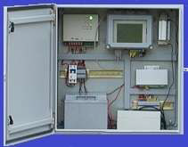
Water Level Gauge system
Microprocessor / Micro-controller based solid state controller.
Self-Reporting at predefined time interval
Selectable Station ID
Local Data Storage for one year with Data retrieval facility
Programmable Data Storage interval from 1.00 min to 24.00 Hrs.
Local Display facility using VGA graphics LCD display
Two RS-232 ports, One RS-485 port, One SDI-12 port, One Ethernet Port & Two USB ports
Long range data Transmission--- Using VHF / UHF / GSM / GPRS / VSAT / INSAT/GOES / Lease Line networks
Easy to Read & Calibrate
Auto Reset facility after one year
Improved accuracy
Input power voltage 12-19 V Solar power supply
GPS Receiver (Optional)
Remote Programmable
Mechatronics Systems Pvt. Ltd.

Slide 23
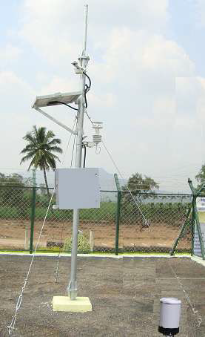
MECH HYDRO-MET SYSTEM
Self-Reporting at predefined time interval.
Selectable Station ID.
Local Data Storage for one year having Data retrieval facility
Local Display facility using VGA graphics LCD display
Two RS-232 ports, One RS-485 port, One SDI-12 port, One Ethernet Port & Two USB ports.
Long range data Transmission--- Using VHF / UHF / GSM / GPRS / VSAT / INSAT/GOES / Lease Line networks.
Easy to Read & Calibrate
Auto Reset facility after one year.
Improved accuracy.
Input power voltage 12-19 V Solar power supply.
GPS Receiver (Optional)
Remote Programmable
Mechatronics Systems Pvt. Ltd.

Slide 24
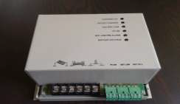
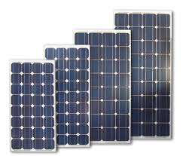
Online Battery Charger for solar
Model MECH OBCS
MECH OBCS delivers 10 A of output current at 12VDC
Versatile charger input ranges 12-20 VDC.
Charge level monitor provides an indication of the battery charge, battery low on LED.
Power failure indication on LED with potential free contact.
Reverse polarity indication for output.
Output over load protection.
Over voltage protection for Input and Output.
Mechatronics Systems Pvt. Ltd.

Slide 25
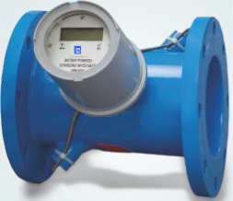
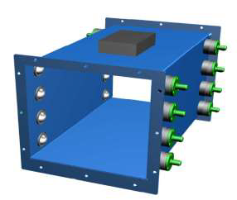
MECH – Ultrasonic Smart Flow meter
Design to work in harsh environment
Self-Reporting at predefined time interval.
Selectable Station ID.
Local Data Storage for one year
RS-232 interface for Data retrieval
VGA graphics LCD display
Measure & display cumulative flow, flow rate, velocity with time & date stamp
GSM / GPRS data communication.
Easy to Install & Maintain
Improved accuracy.
Self adjusting to adopt changes in pipe diameter due to scaling and corrosion.
Fast response
AMR function available
5 year battery life, no external power required
Remote Programmable
Self diagnostic function to indicate the faults
Multi cross path up to 32 array
IP 68 protection
Mechatronics Systems Pvt. Ltd.

Slide 26
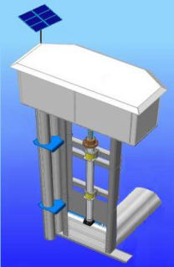
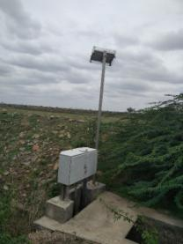
Auto Flow Gates for Canal Networks
Solar powered Smart gate for canal control and monitoring
Inbuilt Flow Measurements.
Minimal Power requirements
Suitable for Solar /DC/ AC power
Suitable to Retrofit on existing gate structure
Inbuilt Gate Position sensor with digital Readout
Limit switches (High, Low, near high, near low)
Interface with almost all RTUs/PLC
Push-buttons for Local operations
RS-485, SDI-12, RS 232 Interface
MODBUS / PROFIBUS protocols
Suitable for Local/Remote/Automatic control.
Flow measurement Accuracy better than +/- 2.5 %
Programmable units of Measurements FPS / MKS
Suitable to Integrate with SCADA network
Level measurement using ultrasonic/Pressure type level sensor.
Robust construction for Field Operation
Powers-supply 12 VDC / solar power / 1 phase AC

Slide 27
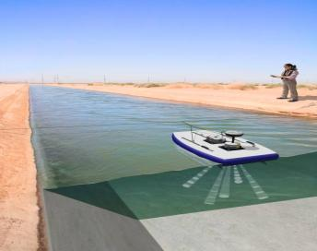
Canal Discharge Measurement Stations
Side looking Doppler are installed at designated point, to measure velocity, and discharge accurately.
Considering heavy siltation problem the canal profile will be monitored at regular intervals Four Doppler Canal profiler device are provided.
Mechatronics Systems Pvt. Ltd.

Slide 28
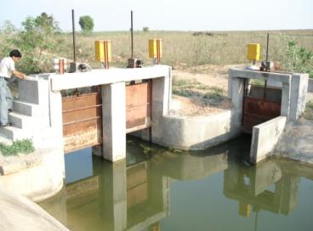
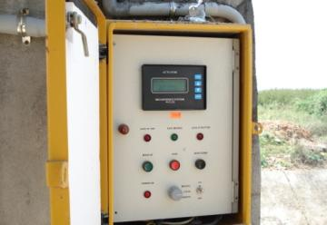
Gate Actuators and Automation of Radial Gates of Dams and Canals
MECH-ACT is specially designed gate actuators for operation of gates in Dams and Canals.
Automated Control Panels, with intelligent RTUs, interface with gate motors and level sensors, measures gate positions, discharge measurement, for an automatic control of Gates
Gates can be controlled based on set discharge, set level, set gate opening.
Two way communication with master station for remote automated control of reservoirs or canals.
Mechatronics Systems Pvt. Ltd.

Slide 29
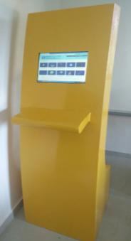
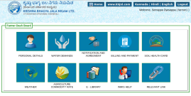
Farmer Information Kiosk
Customized for Irrigation and water management applications
Backed by huge data base and algorithms and compatibility with other applications like GIS/MIS etc.
Fast data analysis and query handling
Replicability and scalability
Multi-lingual support
Individual farm & soil health details
Irrigation schedule
Water requirement & allotment
Crop details
Water consumption & Billing
Data from agriculture commodity Markets
DSS feedback to forecast production
Individual farmer level crop plans
Maintaining log books & disseminated to community
Mechatronics Systems Pvt. Ltd.

Slide 30
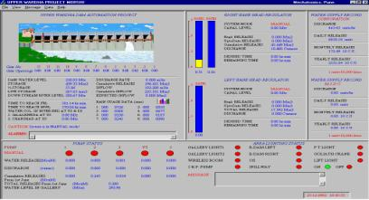
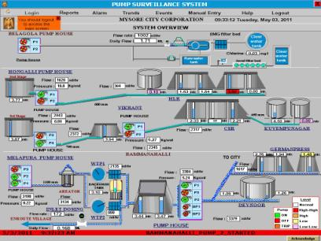
SCADA software
The MECH SCADA /MMI Software is a complete automation solution providing graphical visualization, Data acquisition and Supervisory Control for field instrumentation program.
The MECH SCADA system is comprises of host software automation solutions including remote telemetry systems, remote terminal units (RTU), programmable logic controllers (PLCs) which are typically installed in remote areas. Communication is over long distances to the host system.
Tools for viewing historical data and generating Maintenance & Management reports.
An event scheduler is provided for performing tasks at specific times, such as generating & printing reports.
Mechatronics Systems Pvt. Ltd.

Slide 31
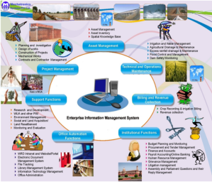
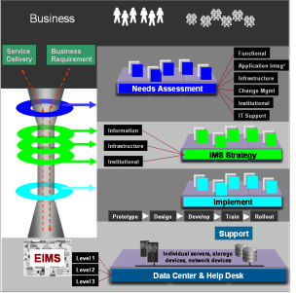
EIMS software
Enterprise Information Management System (EIMS) provides the right information to the right persons at the right time to facilitate making more informed decisions for water resources departments. The main aim of the application is to create an information backbone and information flow arrangements to create water resources departments deliver cost effective and efficient services. EIMS focuses on the creation and effective use of IT infrastructure and supporting information systems to institutionally strengthen the core functions of water resources departments.
Features:
Integration with SCADA,GIS, INMIS & water supply Monitoring
Real Time Hydro metrological Information
Real Time Reservoir Monitoring
Irrigation monitoring, control and Management
Resource Planning & Management
Water Supply Monitoring, Control and Management
Mechatronics Systems Pvt. Ltd.

Slide 32
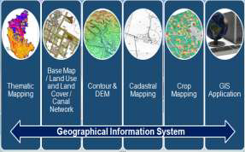
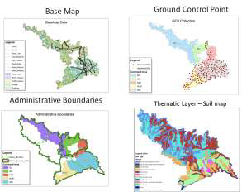
Geographical Information System (GIS)
1. Presenting detailed spatial information for various entities involved in Irrigation Projects.
i. Water Resources - Canal , River , Dam, Water bodies, ground water etc
ii. Land Resources - Soil and its nutrition factors , Farms ,Land Use, Land cover
iii. Hydro Met - Geo-morphology, Weather, Rainfall.
iv. Others - Bridges , buildings , rail and road network etc
2. Swipe and Blend tool for GIS data analysis.
i. WUA , Farmer Information Kiosks data presentation through GIS
ii. Soil Survey, Soil Health
iii. Water demand and Billing details from MIS to GIS
iv. Trend analysis for surface, soil, ground water, Water demand, water supply prospects.
v. GIS data and Modeling.
Mechatronics Systems Pvt. Ltd.

Slide 33
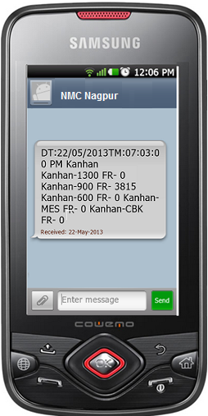
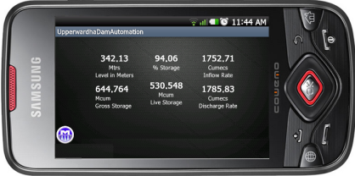
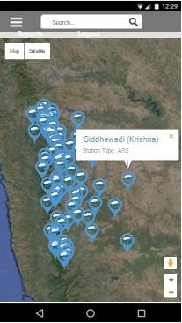
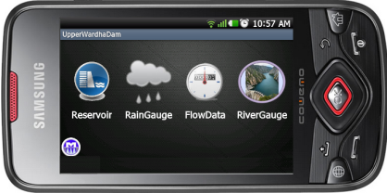
Android/ iOS Application/SMS for real time information dissemination

Slide 34
Success Stories
Mechatronics Systems Pvt. Ltd.

Slide 35
Success Stories
RTDAS
Flood Mgmt
Canal Automation
Smart City Water Supply
RTDAS for Krishna Bhima Basin (MH)
RTDAS for Wainganaga Basin (MP)
RTDAS Karanataka
RTDAS for Goa
Telemetry System for Himachal Pradesh
RTDAS for Tehari Project
Upper Wardha (MH)
Bembla (MH)
Anjenum Project (Goa)
Salauli Project (Goa)
Khadkpurna (MH)
Bhatsa (MH)
Purna Dam (MH)
Chandrabhaga Project
Adan Project (MH)
Wan Project (MH)
Arunawati Project (MH)
Sajnam Project (UP)
IGNP (Raj)
NLBC Project (Karnataka)
AIP (Goa)
SIP (Goa)
Rajghat Project (MP)
NSRC Project (AP)
Surya Canal Project
Rajkot Project (Gujrat)
Mysore (Karanataka)
Nagpur Project (MH)
Achalpur (MH)
Pokhran (Raj)
RTDAS Krishna & Bhima Basin
MSPL Automation
IGNP Canal Automation
Rajkot Water supply project
Mechatronics Systems Pvt. Ltd.

Slide 36
Case Study of Upper Wardha Dam Project
The Wardha River, across which the Upper Wardha Dam is built, is a tributary of the Godavari River.
From its origin, at an altitude of 785 m in Satpura Range from the Multai Plateau in Betul District of Madya Pradesh, the river flows 32 km in Madhya Pradesh and then enters into Maharashtra near the Multai plateau of the Satpuda range
It flows along the entire northern and western border of the Wardha district. After traversing 528 km, it joins Wainganga River and together it is called the Pranhita, which ultimately flows into the Godavari River.
Kar, Wena, Jam and Erai are its left-bank tributaries whereas Madu, Bembla and Penganga are the right-bank tributaries.
The catchment area of 4,302 sq. Km is hilly and forested in its upper reaches from its source and the lower reaches are flat wide valleys.
The project is located near Morshi, about 8 km towards to the east of Morshi and 56 km from the Amaravati town, in the Godavari River Basin.
Total Storage 786 Mm3, Design Flood 19457 Cumecs,
Spillway gates of size 18 X 12 mtrs. 13 nos.
Mechatronics Systems Pvt. Ltd.

Slide 37
Case Study of Upper Wardha Dam Project
Created havoc due to Mowad Dam U/S of Upper Wardha dam breached in 1992 and caused heavy losses to lives & properties on D/S of Upper Wardha dam.
Due to this there was a loss of communication, power failure at Dam site and the spillway gates could not be operated in time.
Similar situation happened in 1994 due to heavy flood.
Experiencing such situations Government of Maharashtra decided to install the real time flood forecasting & flood management system comprising of Hydro-Meteorological data acquisition system (RTDAS) , Decision support system with Spillway & Head Regulator gate automation.
The System was Designed, Developed & Installed in 1997 proved its importance during flood situations in 2002, 2005, 2014, & 2016.
Mechatronics Systems Pvt. Ltd.

Slide 38
Case Study of Upper Wardha Dam Project
Installed System
Spillway Gate Automation – 13 Nos.
Reservoir Level Monitoring & Discharge – 1 No
Left & Right Bank Canal Head Regulator- 3 Nos.
Automated Rainfall Stations – 9 Nos.
Automated River Gauge & Discharge station – 4 Nos.
Water supply flow Measurement – 3 Nos.
Gallery Dewatering Pump Automation – 5 pumps
Area & Gallery Lighting Automation – 1 no.
Remote Monitoring Station – 3 Nos.
VHF Data Communication Network
Mechatronics Systems Pvt. Ltd.

Slide 39
Case Study of Upper Wardha Dam Project
Automation system of Upper wardha project is completed in 1997.
This is first fully Automated water resource management project in India.
This Automation Project Monitor & Control following:
Continuously Monitor Reservoir Level, Gate opening, field data
Control reservoir gate operation as per ROS following gate operation schedule.
Calculate Discharge rate, Inflow rate, expected inflow, contents, % contents, time to reach FRL, time to reach MWL etc.
Monitor & control left & right bank canal head regulator gates
Water supply monitoring, measurement & Bill generation of MIDC, MJP & Morshi Town.
Remote monitoring from sub Division, Division & Circle office.
Mechatronics Systems Pvt. Ltd.

Slide 40
Case Study of Upper Wardha Dam Project
Mechatronics Systems Pvt. Ltd.

Slide 41
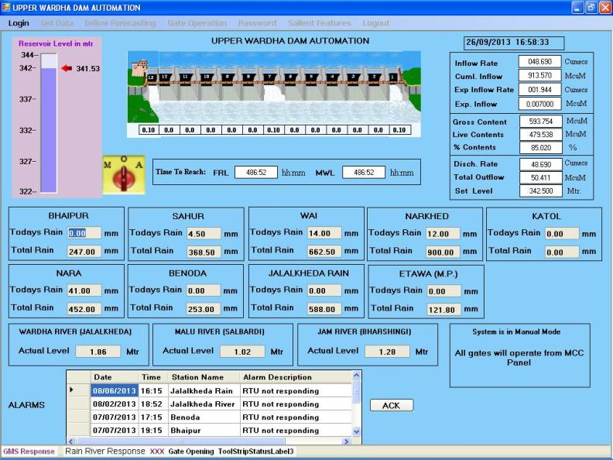
Case Study of Upper Wardha Dam Project
Mechatronics Systems Pvt. Ltd.

Slide 42
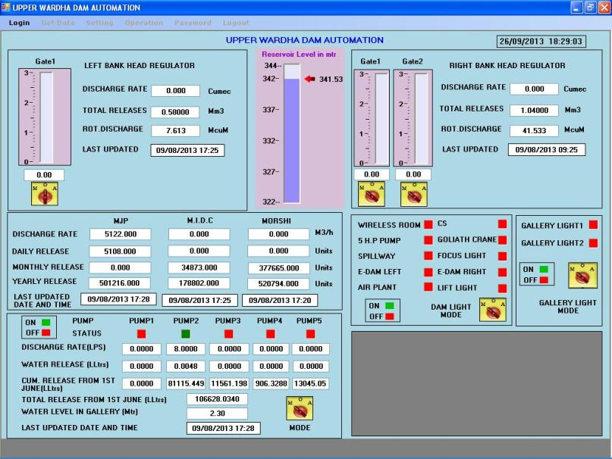
Case Study of Upper Wardha Dam Project
Mechatronics Systems Pvt. Ltd.

Slide 43
Case Study of Upper Wardha Dam Project
Optimisation of water storage
Real time remote reservoir monitoring and control
Instantaneous Decision making
Advanced flood forecasting & early warning
Efficient flood routing avoiding damages to lives & properties without affecting dam safety.
Reduction / Elimination of man-made errors
Easy and efficient model analysis for further use
Single room control.
Reduction in operational & maintenance costs.
Better service to the water users resulting increase crop produce
Easy & accurate water supply management resulted increase in revenue
Better response to emergencies
Mechatronics Systems Pvt. Ltd.

Slide 44
Case Study of RTDAS Krishna & Bhima Basin
Mechatronics Systems Pvt. Ltd.

Slide 45
Case Study of RTDAS Krishna & Bhima Basin - Background
The geographical area of Maharashtra state is 308 Thousands Km2.
Major river basins in the state are the Krishna river with its major tributary as Bhima, Godavari, Tapi and the West flowing rivers of Konkan strip.
Maharashtra receives rainfall from both south-west and north-east monsoon.
The state has very highly variable rainfall ranging from 6000 mm in upper catchments to 400 mm in shadow areas of lower catchments.
Majority of rainfall mainly occurs in a four months period between June to September with the number of rainy days varying between 40 to 100 .
The state experiences flash floods particularly in Western Ghats including Krishna and Upper Bhima basins. For instance, Sangli and Kolhapur districts in Krishna Basin and Pune and Solapur districts in Bhima basin experienced severe flood several times during recent decade.
Mechatronics Systems Pvt. Ltd.

Slide 46
Case Study of RTDAS Krishna & Bhima Basin - Scope
Automatic Rain Gauge (ARG) Stations: It is proposed to install new ARGs at 127 locations in the project area
Full Climate Stations (FCS): In the project area it is proposed to install FCS at 42 locations
Gauge Discharge (GD) Stations: Along the river Krishna, Bhima and its major tributaries, it is proposed to install 37 gauge discharge (GD) stations out of which 2 GD stations have ARG and 2 GD stations have FCS combined at these locations.
Reservoir Level and Outflow Stations: There are 46 Reservoir level and outflow stations in this project . 26 Reservoir have 171 gate sensors.
Mechatronics Systems Pvt. Ltd.

Slide 47
Case Study of RTDAS Krishna & Bhima Basin - Scope
Establishing Hybrid Data communication network of VSAT and GSM/GPRS.
Satellite data communication network along with the VSAT MASTER station at Sinchan Bhavan Pune and 93 remote stations
Establishing GSM/GPRS data communication network with the GSM/GPRS receiving center at Sinchan Bhavan Pune and 156 remote stations
Out put the Real Time Data in required format for further Analysis and flood estimation.
Develop Web Based application software
Operation & Maintenance for 5 Year Period.
Mechatronics Systems Pvt. Ltd.

Slide 48
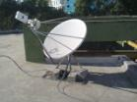
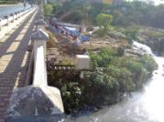
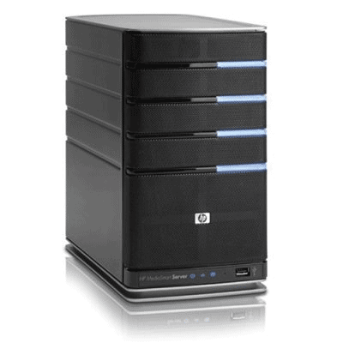
Case Study of RTDAS Krishna & Bhima Basin – VSAT network
VSAT
VSAT
Satellite
River Level
Weather station
RTDAS Software
VSAT DATA Server
Reservoir Level
Rainfall
Data Collection Platform
Data Centre at Sinchan Bhavan
Mechatronics Systems Pvt. Ltd.

Slide 49
Case Study of RTDAS Krishna & Bhima Basin –GSM/GPRS network
GSM/GPRS
Network
GSM/GPRS Modem
GSM/GPRS Modem
Weather station
Rainfall
River Level
GSM/GPRS Data Collection System
RTDAS Software
Data Collection Platform
Data Centre at Sinchan Bhavan
Mechatronics Systems Pvt. Ltd.

Slide 50
Case Study of RTDAS Krishna & Bhima Basin – Data Centre
GSM/GPRS Modem
VSAT Modem
Quality Control Server
GSM/GPRS Data Server
VSAT Data Server
LAN
Printer
Work Station
Display
DSS Server
Mechatronics Systems Pvt. Ltd.

Slide 51
Case Study of RTDAS Krishna & Bhima Basin – Rainfall
Mechatronics Systems Pvt. Ltd.

Slide 52
Case Study of RTDAS Krishna & Bhima Basin – Rainfall
Mechatronics Systems Pvt. Ltd.

Slide 53
Case Study of RTDAS Krishna & Bhima Basin – River Gauge
Mechatronics Systems Pvt. Ltd.

Slide 54
Case Study of RTDAS Krishna & Bhima Basin – River Gauge
Mechatronics Systems Pvt. Ltd.

Slide 55
Case Study of RTDAS Krishna & Bhima Basin – River Gauge
Mechatronics Systems Pvt. Ltd.

Slide 56
Case Study
KRISHNA BHAGYA JAL NIGAM LTD. NARAYANPUR LEFT BANK CANAL SMART IRRIGATION MANAGEMENT & CANAL AUTOMATION
Mechatronics Systems Pvt. Ltd.

Slide 57
Case Study of KBJNL
Narayanpur Dam is located on Krishna river near Bachihal and Siddapur village of Bijapur District .
This reservoir caters to the irrigation needs of a very vast area of about 5.4 lakh hectares.
The reservoir supplies water to Narayanpur Left Bank canal.
Narayanpur Left Bank canal (NLBC) is the biggest and the main artery of canal network about 77 Kms.
Designed to discharge of 10,000 cusecs to irrigate 4.50 Lakhs Ha.
The network also includes Hunasagi Branch Canal, Indi Branch Canal, Jewargi Branch Canal, Mudbal Branch Canal, and Shahpur Branch Canal and Indi Lift Canal and sub systems
Mechatronics Systems Pvt. Ltd.

Slide 58
Case Study of KBJNL
Mechatronics Systems Pvt. Ltd.

Slide 59
SCOPE OF WORK
Case Study of KBJNL
Providing and fixing SCADA “Integrated Automatic Gates” at 30 distybutory gates, 335 laterals and DPOs
SCADA software comprising of Control, Regulation and Simulation
Irrigation Network Management Information System (INMIS), Planning based on Demands and availability of water before start of the season,
Geographical Information System (GIS), base map creation and updation every season, Crops mapping, Soil Health, Weather, Water Use, Demand etc.
210 farmer Information Kiosks, as part of Water Allocation Management, and as a tool for information collection and dissemination to Water User Cooperative Societies
Automation of existing 41 HR/CR/Escape gates on NLBC main Canal with Mechanical Refurbishing and electrical retrofitting
Establishing Wireless DATA communication network
Establishing Master control station and training center at Narayanpur
Establishing 10 Remote Monitoring Stations
Operation & Maintenance for 5 years
Mechatronics Systems Pvt. Ltd.

Slide 60
Case Study of KBJNL
Overall Architecture
Crop water requirement & soil health
Distributaries, laterals, DPO’s
CR & Escapes
Mechatronics Systems Pvt. Ltd.

Slide 61
Case Study of KBJNL – Fully Integrated Automated gate
Antenna
Solar Panel
Camera
Pole Mast
Solar Hoist
Remote Terminal Unit (RTU)
Hand Wheel (Removable)
Grating
Battery
Protective Enclosure
Ultrasonic Level Sensor (D/S)
Ultrasonic Level Sensor (U/S)
ULTRASONIC SENSOR WELL
ULTRASONIC SENSOR WELL
Stem NUT
Gate Guide Frame
GATE
VENT
Mechatronics Systems Pvt. Ltd.

Slide 62
Case Study of KBJNL – Gate Installation & Retrofitting
Mechatronics Systems Pvt. Ltd.

Slide 63
Case Study of KBJNL – Farmer Information Kiosk
Mechatronics Systems Pvt. Ltd.

Slide 64
Case Study of KBJNL – Farmer Dash Board
Mechatronics Systems Pvt. Ltd.

Slide 65
Case Study of KBJNL – Water Demand
Mechatronics Systems Pvt. Ltd.

Slide 66
Case Study of KBJNL – Water Bill
Mechatronics Systems Pvt. Ltd.

Slide 67
Case Study of KBJNL – Soil Health Card
Mechatronics Systems Pvt. Ltd.

Slide 68
Case Study of KBJNL – State level commodity rates
Mechatronics Systems Pvt. Ltd.

Slide 69
Case Study of KBJNL – GIS
Thematic Mapping
Base Map / Land Use and Land Cover / Canal Network
Contour & DEM
Cadastral Mapping
Crop Mapping
GIS Application
Mechatronics Systems Pvt. Ltd.

Slide 70
Base Map
Case Study of KBJNL – GIS
Ground Control Point
Administrative Boundaries
Thematic Layer – Soil map
Mechatronics Systems Pvt. Ltd.

Slide 71
Thematic Layer-Geomorphology
Case Study of KBJNL – GIS
Thematic Layer-Ground water
Thematic Layer-Lithology
Thematic Layer-Well Location
Mechatronics Systems Pvt. Ltd.

Slide 72
Case Study of KBJNL – Canal Control Software
Mechatronics Systems Pvt. Ltd.

Slide 73
Case Study of KBJNL – Canal Control Software
Mechatronics Systems Pvt. Ltd.

Slide 74
Case Study of KBJNL – Canal Control Software
Mechatronics Systems Pvt. Ltd.

Slide 75
Case Study of KBJNL – INMIS
INMIS
Crop Revenue (Billing & Revenue Collection)
Asset
Water User Co-Op Society
Soil Health Card
Farmer Registration
Water Demand
Notification
Agreement
Irrigation Recording
Water Bill & Payments
Mechatronics Systems Pvt. Ltd.

Slide 76
Case Study of KBJNL – INMIS – Farmer Registration
Mechatronics Systems Pvt. Ltd.

Slide 77
Case Study of KBJNL – INMIS – Revenue Report
Mechatronics Systems Pvt. Ltd.

Slide 78
Case Study of KBJNL – INMIS – Water Demand Report
Mechatronics Systems Pvt. Ltd.

Slide 79
Thank You

